Slide 1
Learner engagement
Gamification

Slide 2
Session objectives
Identify five potential areas of gamification in anatomy teaching learning
Identify two methods of gamification other than routine MCQs

Slide 3
How to continuously engage?
Understand the needs and skills of your learners
Use personalization
Be open to communication and feedback
Use interactivity
Overcome the barriers to engagement with a robust LMS

Slide 4
Gamification
Use of elements of game design to increase user engagement
Improve motivation
Participation
Returns on time investment
Ref: Christa et al, Gamification as a tool for enhancing graduate medical education, https://pmj.bmj.com/content/postgradmedj/90/1070/685.full.pdf

Slide 5
Not just Quiz – with MCQs !
Anatomy has more ways to gamify
Drag and drop
Interactive video

Slide 6
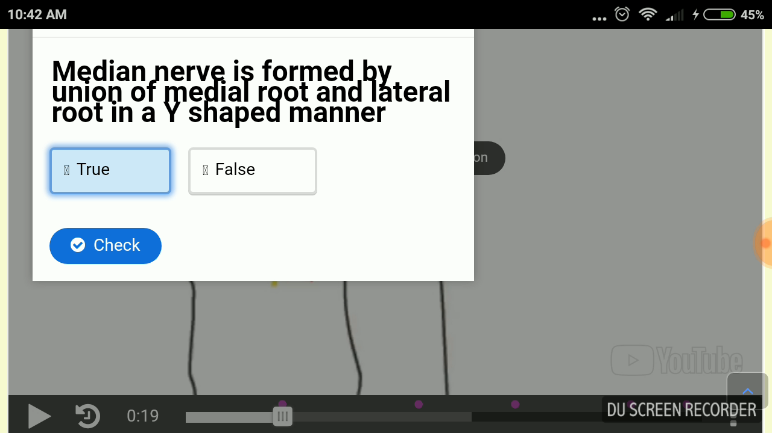

Slide 7
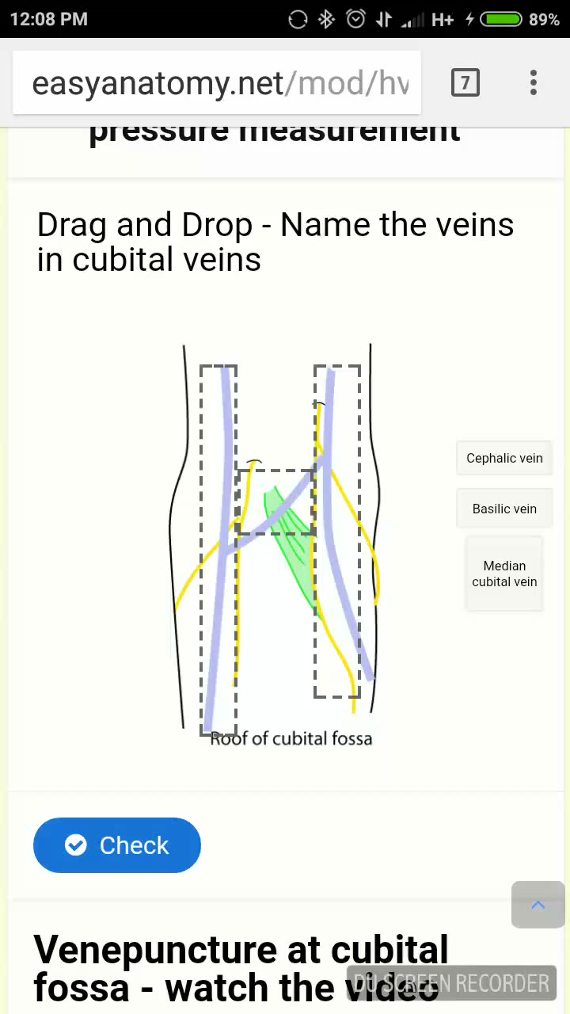

Slide 8
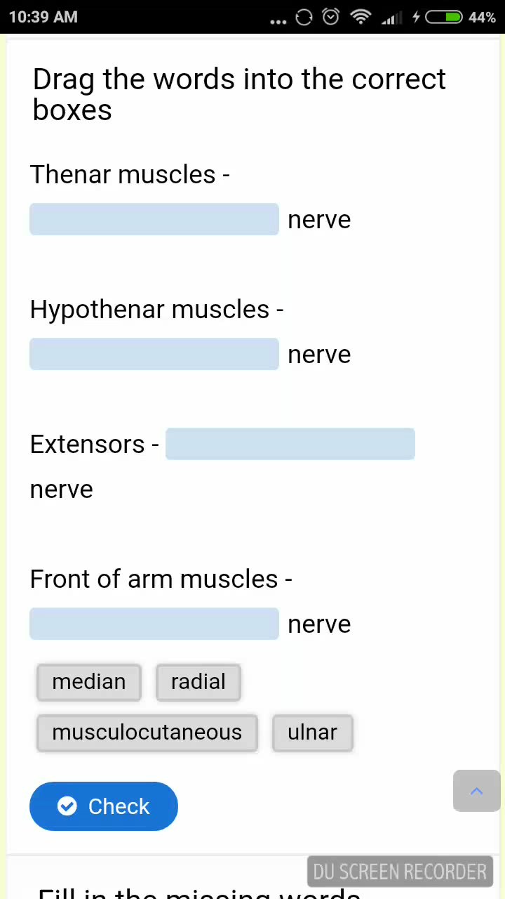

Slide 9
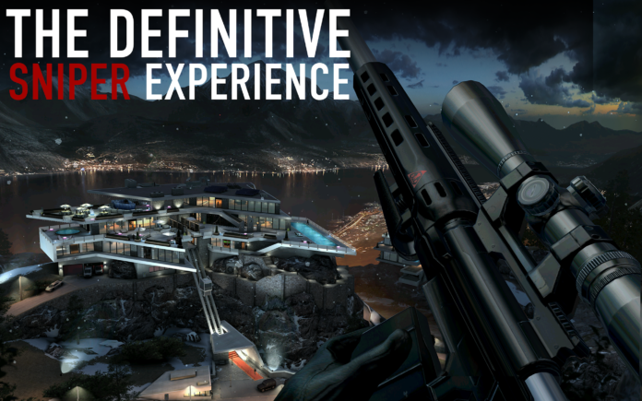
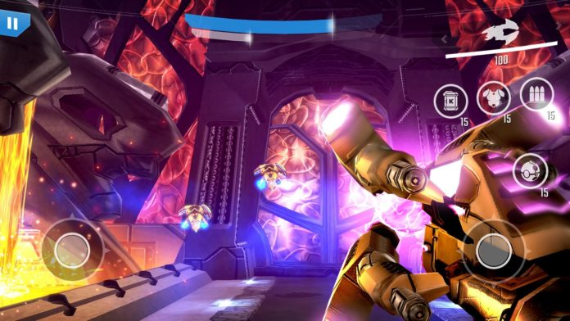
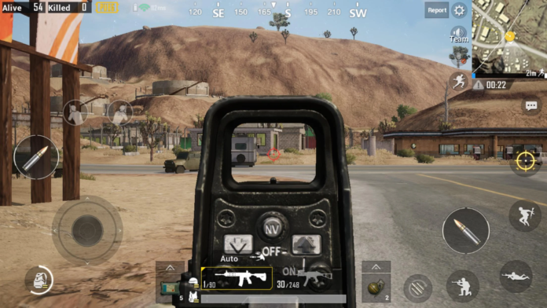
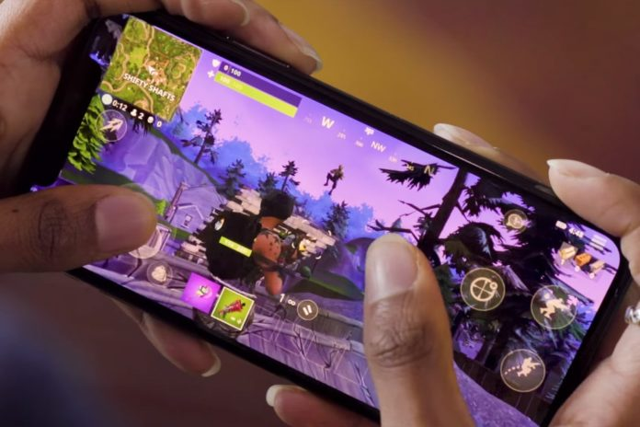
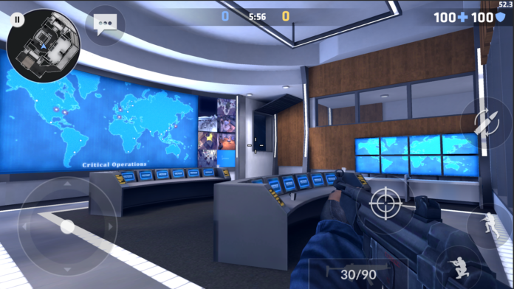
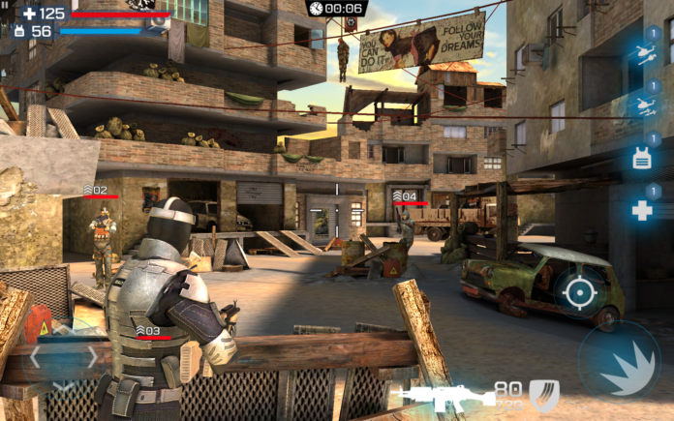
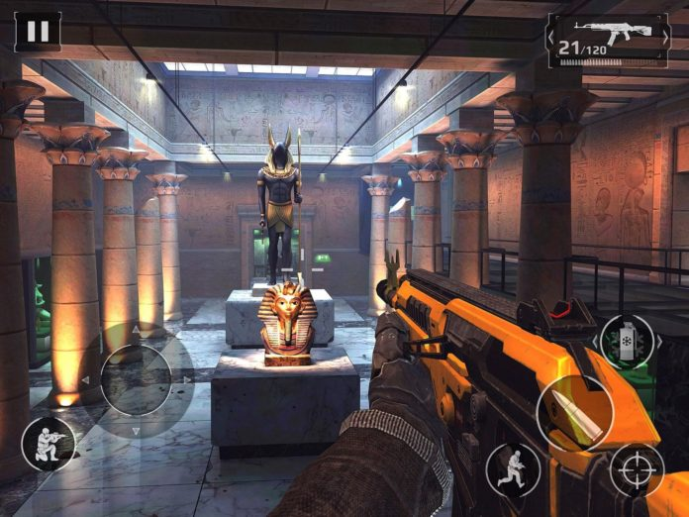
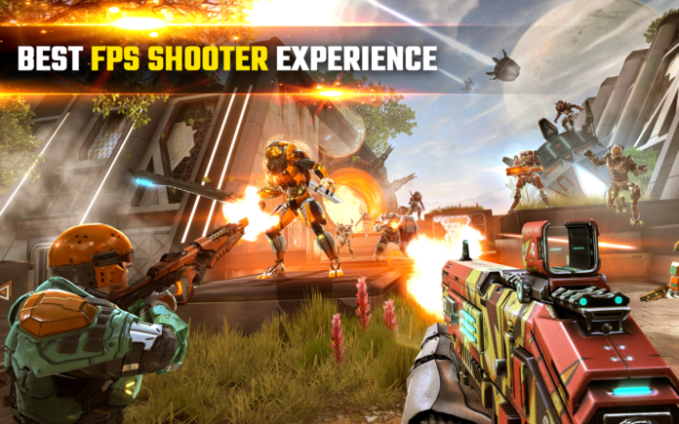
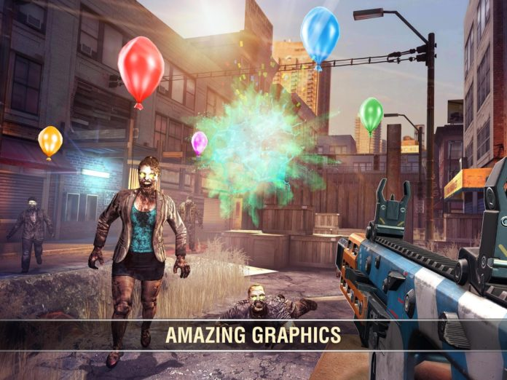
Design realistic mobile games to learn anatomy!

Slide 10

Students are smarter
We need to design and adopt smarter teaching learning methods

