Slide 1
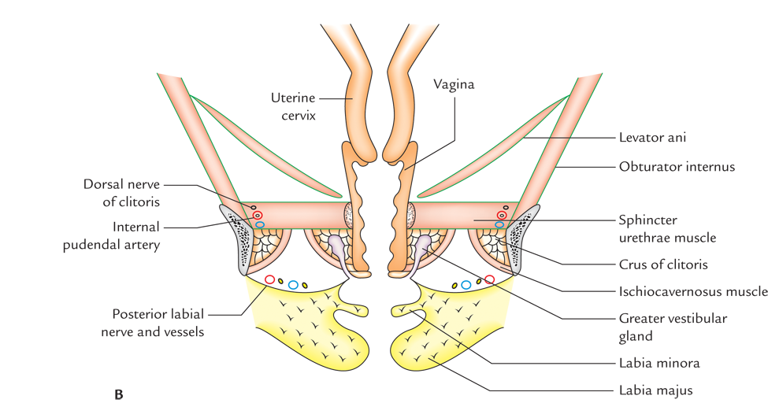
Coronal section of female pelvis
Notes:
Flipped classroom is a form of blended learning in which student learns new content online by watching video lectures, usually at home, at his will. What used to be the home work or expected integration or assigned problems are done in class with teachers offering more personalised guidance and interaction with students, instead of lecturing

Slide 2

Peritoneum
Cervix
Hip bone
Ischioanal fossa
Obturator
internus
Levator ani
Corpora cavernosus + Ishiocavernosus
Sphincter urethrae
Colles’ fascia
Bulbospongiosus
Coronal section of female pelvis
Bartholin’s glands

