Slide 1
Supplementary devices
Hardware requirement

Slide 2
Objectives
To enumerate the two hardware tools that can supplement during creation of medical illustrations

Slide 3
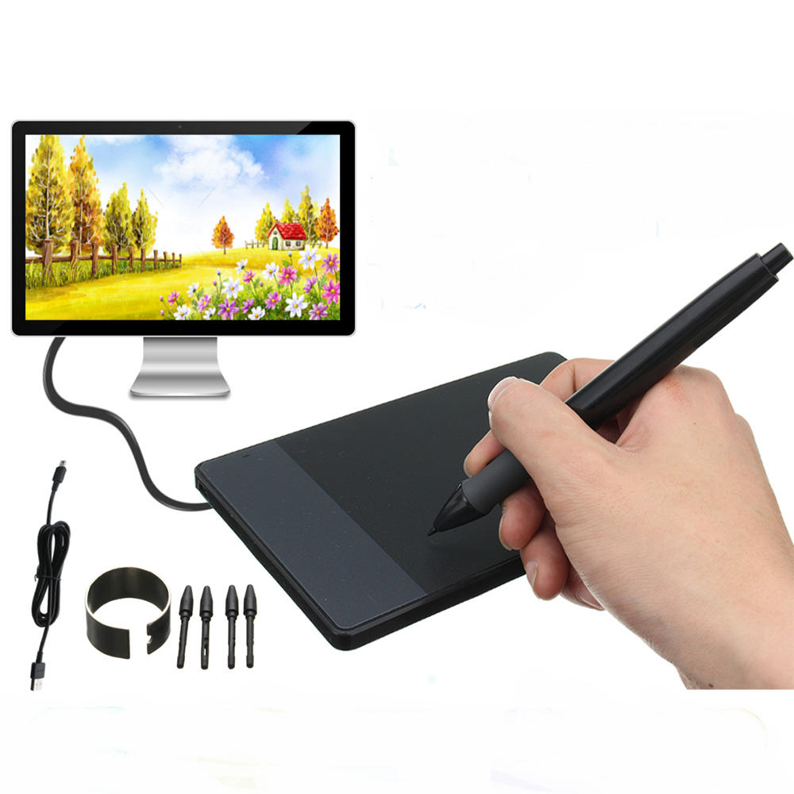
Tablets for graphic design
Active area
Features
Hot keys
Stylus
Pressure sensitivity
Resolution
Scrollers
Wireless or corded

Slide 4
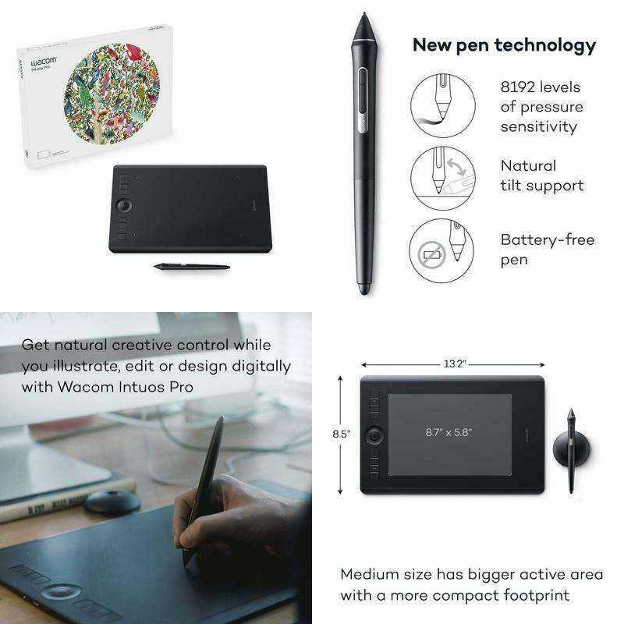
Wacom Intuos Pro Digital Graphic Drawing Tablet
https://www.youtube.com/watch?v=fFeU68nACy4

Slide 5
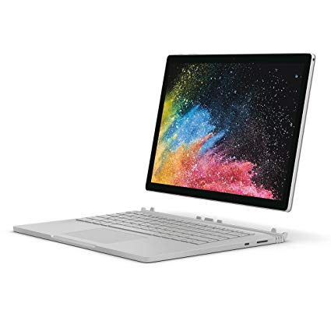
Surface book
https://www.youtube.com/watch?v=q1rmCBvXeg0
Surface book
Pen
Dial

Slide 6
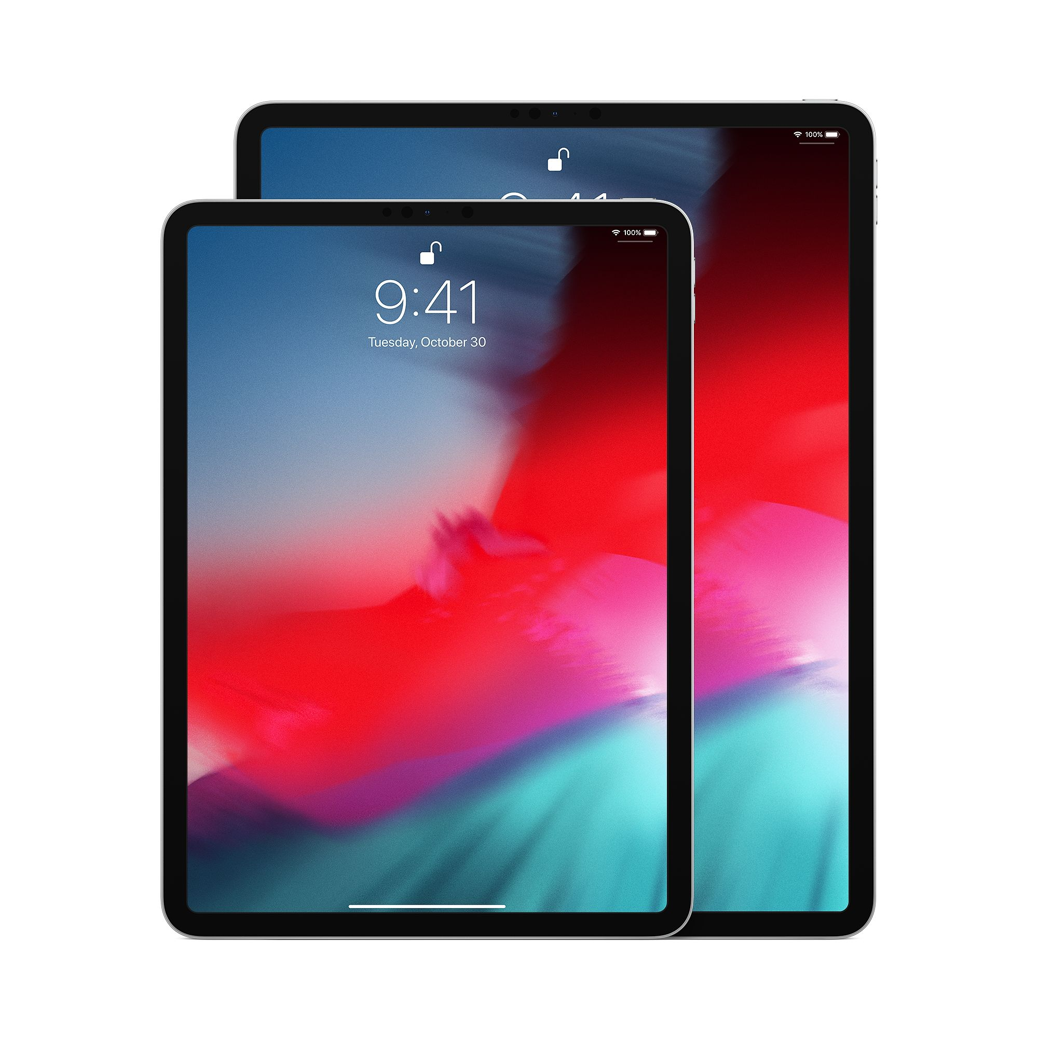
iPad pro
https://www.youtube.com/watch?v=4FGEX8yZqiM
Pencil Artist Review
https://www.youtube.com/watch?v=VMA25CqKcn8

Slide 7
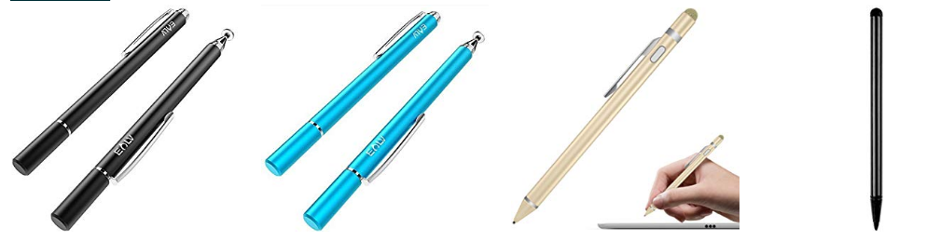
Stylus for drawing
Adonit Jot Pro
LynkTec TruGlide Pro
Adonis Dash 3
WEALLNERSSE Active Stylus
MoKo Universal Active Stylus

Slide 8
Mobile with pen
Can not achieve complex illustrations

Slide 9
Thank you
Disclaimer – I am not endorsing any of these devices!

