Slide 1
Keyframes
A Key to animation

Slide 2
Session objectives
To define the keyframe and to name the software that supports keyframes
To insert a keyframe in blenders
To name two vector graphics editors
To design and save a simple illustration as SVG

Slide 3
Keyframes are markers in time
Spatial position
Opacity
Scale
Rotation
Amount
Particle count
Color

Slide 4
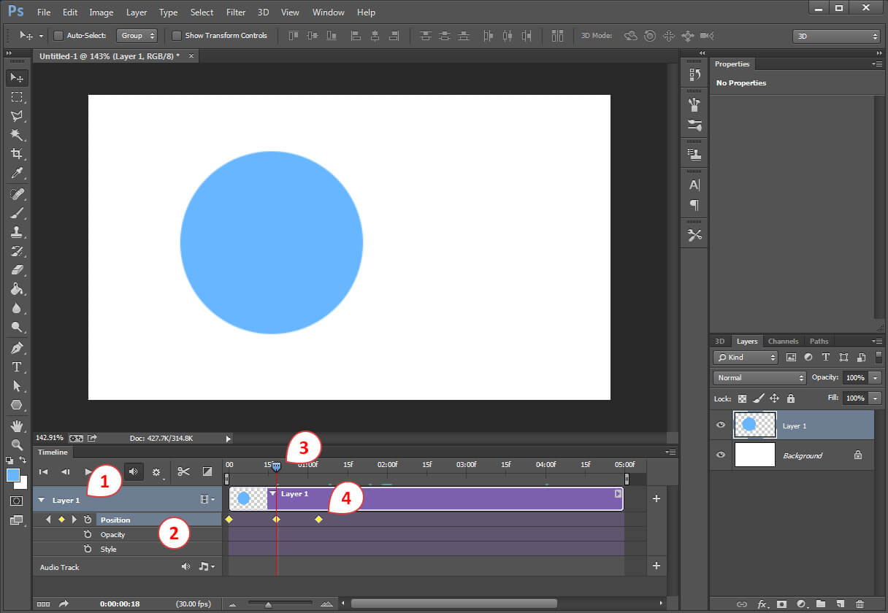
Keyframes are added in the timeline
Timeline in Adobe Photoshop
Image source: https://www.smashingmagazine.com/2015/06/creating-advanced-animations-in-photoshop/

Slide 5
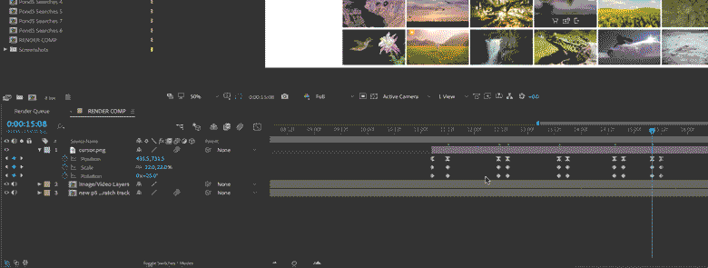
Timeline in Adobe after effects
Image source: https://helpx.adobe.com/in/after-effects/using/setting-selecting-deleting-keyframes.html

Slide 6
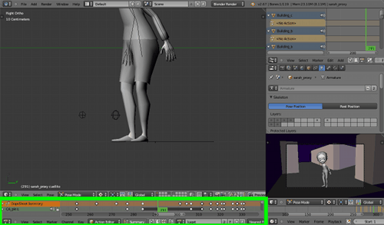
Timeline in Blenders
Image source: https://docs.blender.org/manual/en/latest/animation/keyframes/introduction.html

Slide 7

Timeline in Google Web designer
Image source: https://webdesigner.withgoogle.com/

Slide 8
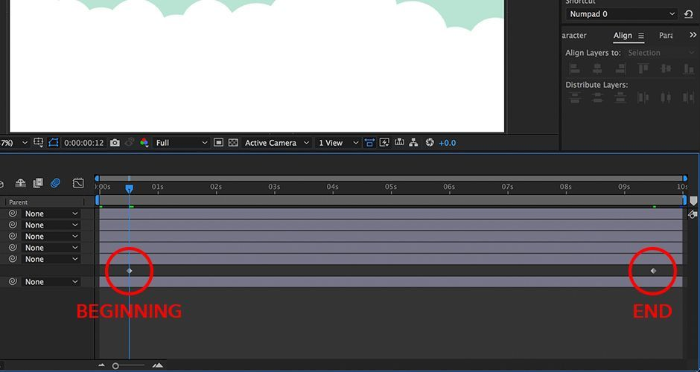
Image source: https://www.schoolofmotion.com/blog/how-to-set-keyframes-after-effects

Slide 9
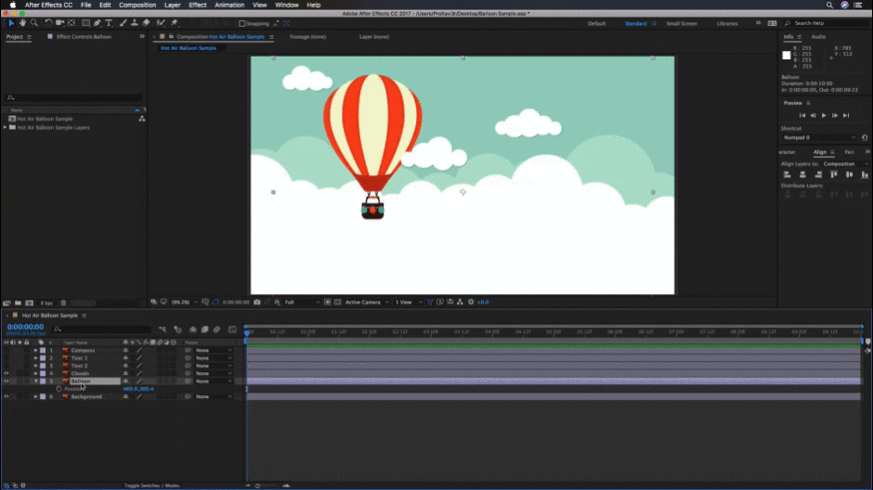
Image source: https://www.schoolofmotion.com/blog/how-to-set-keyframes-after-effects

Slide 10
Examples

Slide 11
JPEG
PNG
https://www.youtube.com/watch?v=yG9kCD3cGuM
https://www.youtube.com/watch?v=IGkSBlDBOBE
Development of kidney – rotation of hilum
Change in the Position

Slide 12
Vector
https://www.youtube.com/watch?v=Lnkgzzv4IW4
https://www.youtube.com/watch?v=lyqynilfnV8
Ectopic kidneys
Tongue development .flv file
https://www.youtube.com/watch?v=lcRNI7QRjzo
Change in the Shape

Slide 13
Ectopic urter
https://www.youtube.com/watch?v=EKjgC4OhXOk

Slide 14
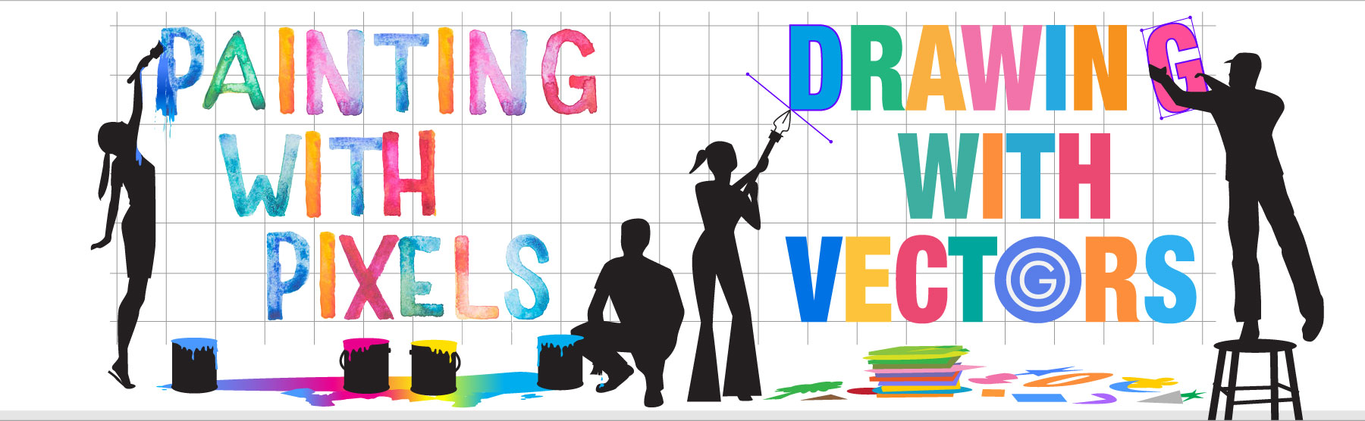
Raster vs Vector
Image source: https://vector-conversions.com/vectorizing/raster_vs_vector.html

Slide 15
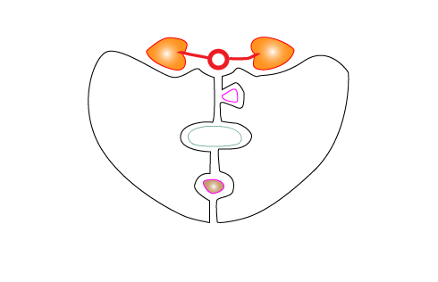
Vector - characteristics

Slide 16
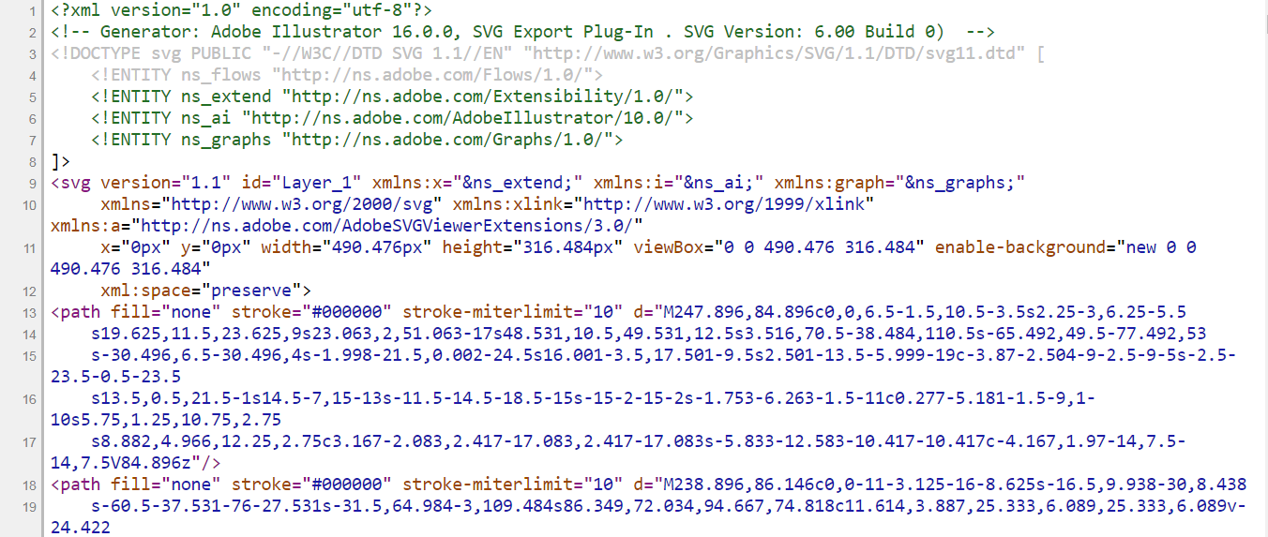

Slide 17
For more details
https://youtu.be/mrrIBzDMlNw

Slide 18



How to make a vector?
Inkscape
Adobe Illustrator
Affinity designer
https://inkscape.org/
https://www.adobe.com/in/products/illustrator.html
https://affinity.serif.com

Slide 19
How to make a vector - online?
Vectr
Drawing SVG
https://vectr.com
www.drawsvg.org/drawsvg.html
Method Draw
Mobile apps
Vector paint
Vector artist
https://editor.method.ac

