Slide 1
Sequence graphics slides of spinal cord and spinal cord

Slide 2
Descending tracts
Ascending tracts
Fasciculus
gracilis
Fasciculus
Cuneatus
Posterolateral tract
Lateral corticospinal tract
Posterior spinocerebellar tract
Rubrospinal tract
Lateral spinothalamic tract
Anterior spinocerebellar tract
Olivospinal
tract
Spino-olivary tract
Vestibulospinal
tract
Anterior spinothalamic tract
Tectospinal
tract
Anterior corticospinal
tract

Slide 3
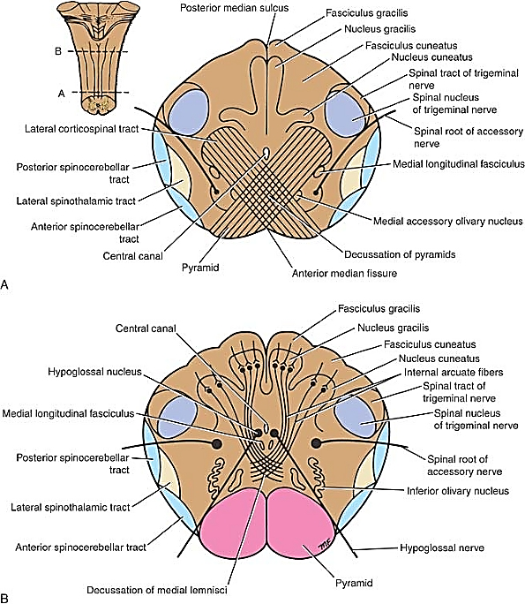
Level of Decussation of Pyramids

Slide 4
Level of Decussation of Pyramids
P
R
L
Fasciculus gracilis
A
Nucleus gracilis
Spinal tract of trigeminal nerve
Fasciculus cuneatus
Spinal nucleus of trigeminal nerve
Nucleus cuneatus
Lateral corticospinal tract
Spinal root of accessory nerve
Posterior spinocerebellar tract
Medial longitudinal
fasciculus
Lateral spinothalamic tract
Anterior spinocerebellar tract
Medial accessory olivary nucleus
Central canal
Decussation of pyramids
Anterior median fissure
Pyramid

Slide 5
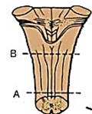
Level of Decussation of Lemnisci

Slide 6
Level of Decussation of Lemnisci
P
R
L
Fasciculus gracilis
A
Central canal
Nucleus gracilis
Spinal tract of trigeminal nerve
Fasciculus cuneatus
Spinal nucleus of trigeminal nerve
Nucleus cuneatus
Internal arcuate
fibres
Hypoglossal nucleus
Spinal root of
accessory nerve
Posterior spinocerebellar tract
Medial longitudinal
fasciculus
Lateral spinothalamic tract
Anterior spinocerebellar tract
Inferior olivary nucleus
Hypoglossal nerve
Pyramid
Decussation of medial fasciculus

Slide 7
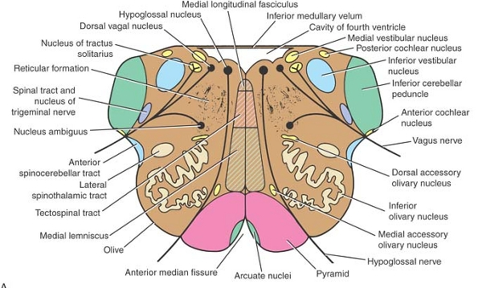
Level of the Olives

Slide 8
Level of the Olives
P
R
L
Medial longitudinal fasciculus
A
Hypoglossal Nucleus
Inferior medullary vellum
Dorsal vagal Nucleus
Cavity of 4th Ventricle
Nucleus tracus solitarius
Medial vestibular N
Posterior cochlear N
Inferior vestibular N
Reticular formation
Spinal tract & N of V
Inferior cerebellar peduncle
Nucleus ambiguus
Vagus nerve
Anterior spinocerebellar tract
Dorsal accessory olivary nucleus
Lateral
spinothalamic tract
Tectospinal tract
Inferior
olivary Nucleus
Media lemniscus
Medial accessory olivary nucleus
Olive
Hypoglossal Nerve
Anterior median fissure
Arcuate nuclei
Pyramid

