Slide 1
Axillary artery

Slide 2
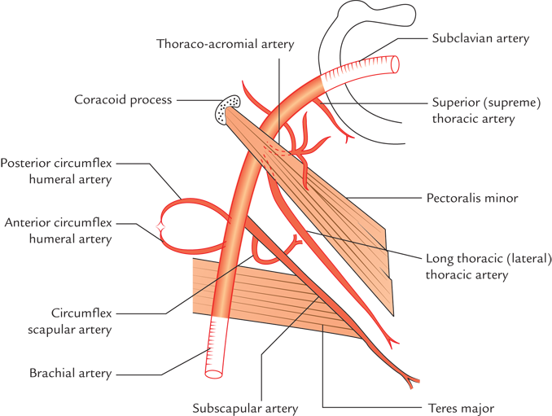

Slide 3
Axillary artery
Artery of axilla
Continuation of subclavian artery
at outer border of first rib

Slide 4
Continues as – brachial artery
At the lower border of teres major
brachial artery

Slide 5
Parts or subdivisions
By Pectoralis minor
Crosses anteriorly
1
2
3

Slide 6
Branches
Superior thoracic artery
1
Thoracoacromial artery
Lateral thoracic artery
2
Posterior circumflex humeral artery
3
Subscapular artery
Anterior circumflex humeral artery

