Slide 1

Unleash the power of PowerPoint Sequence graphics
Dr. Viveka S
Associate Professor,
Department of Anatomy,
Azeezia Institute of Medical Sciences, Kollam

Slide 2
Learning objectives
To define and name the components of sequence graphics
To design (at least) one sequence graphic PowerPoint slide

Slide 3
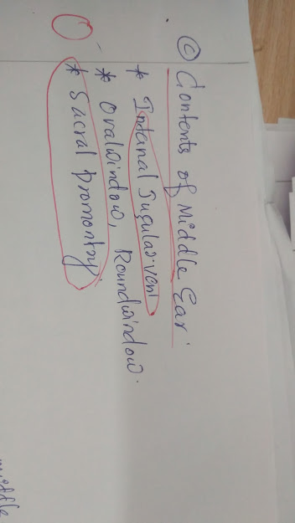
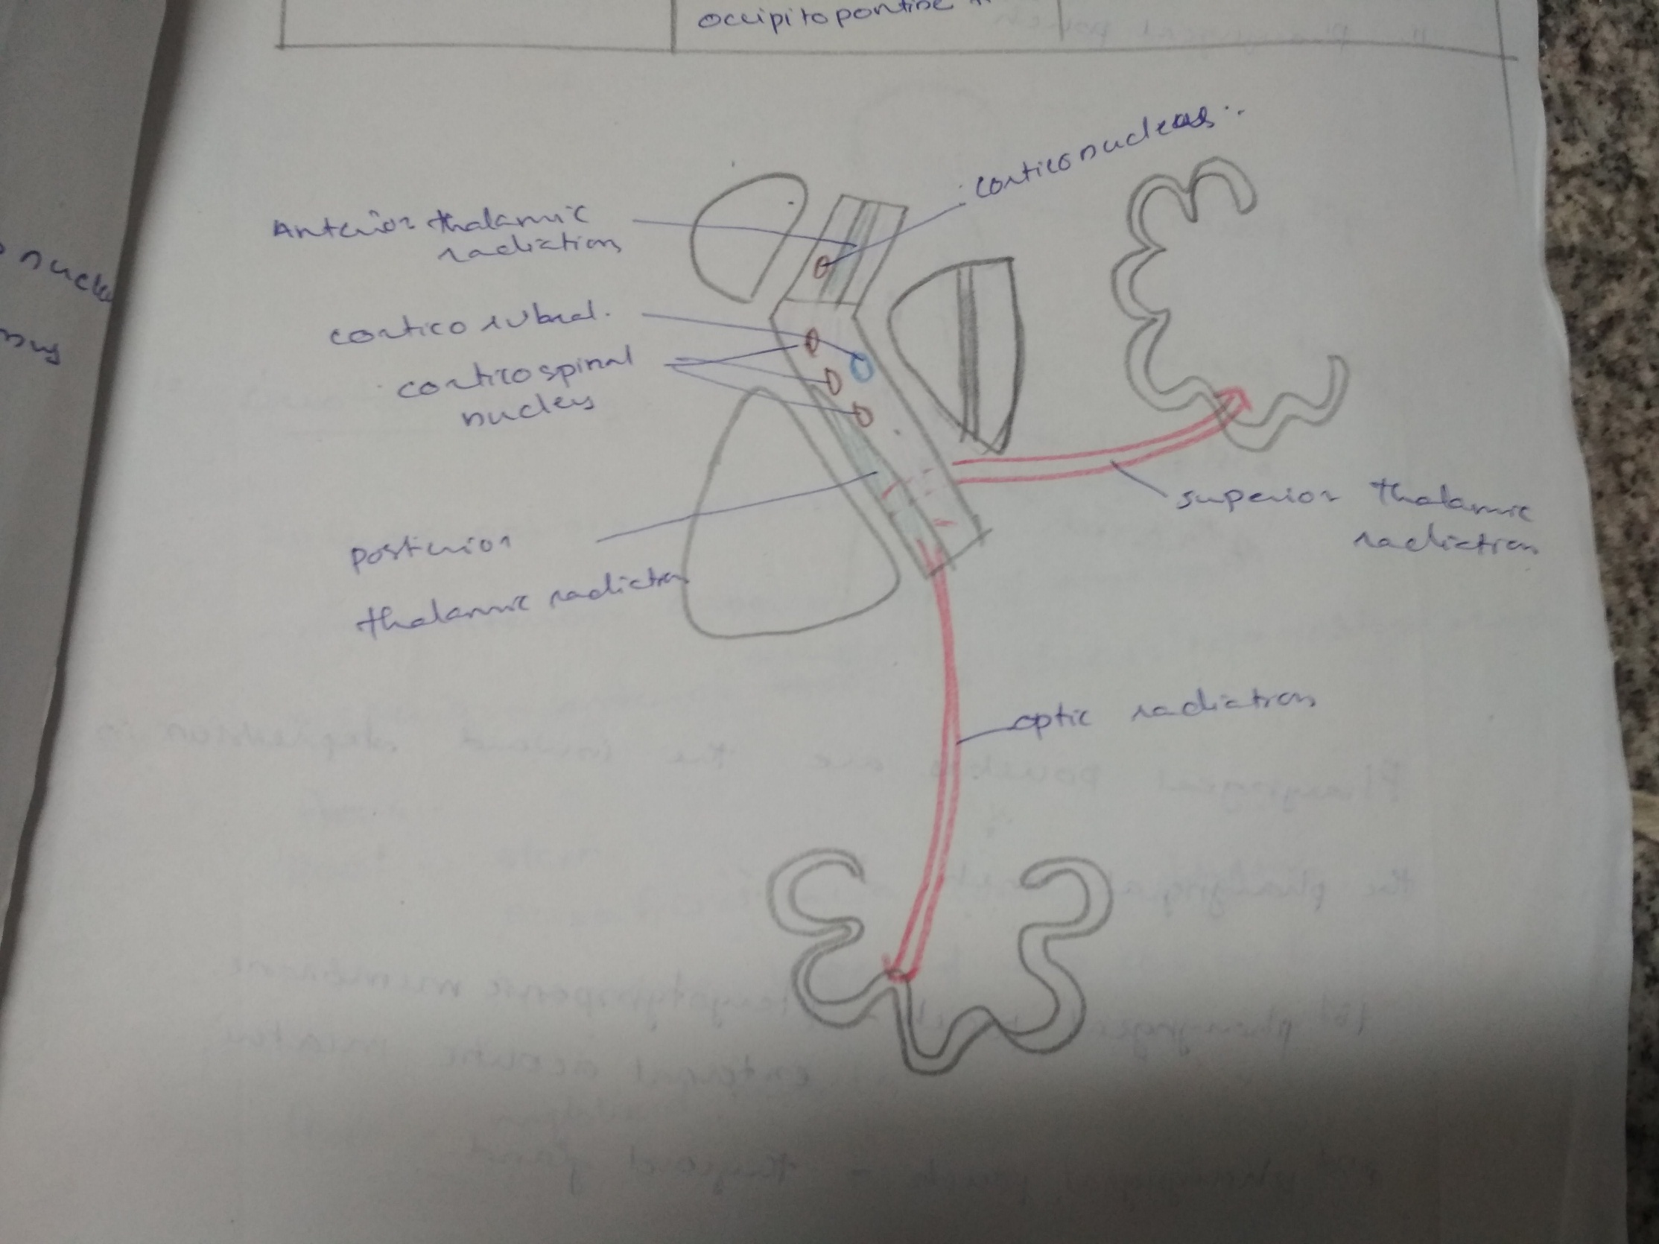
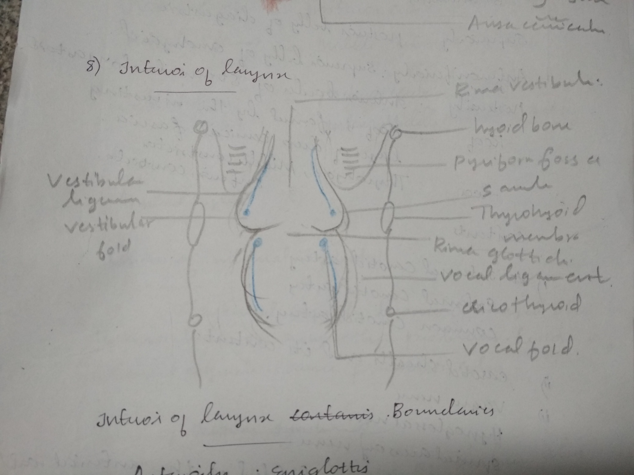
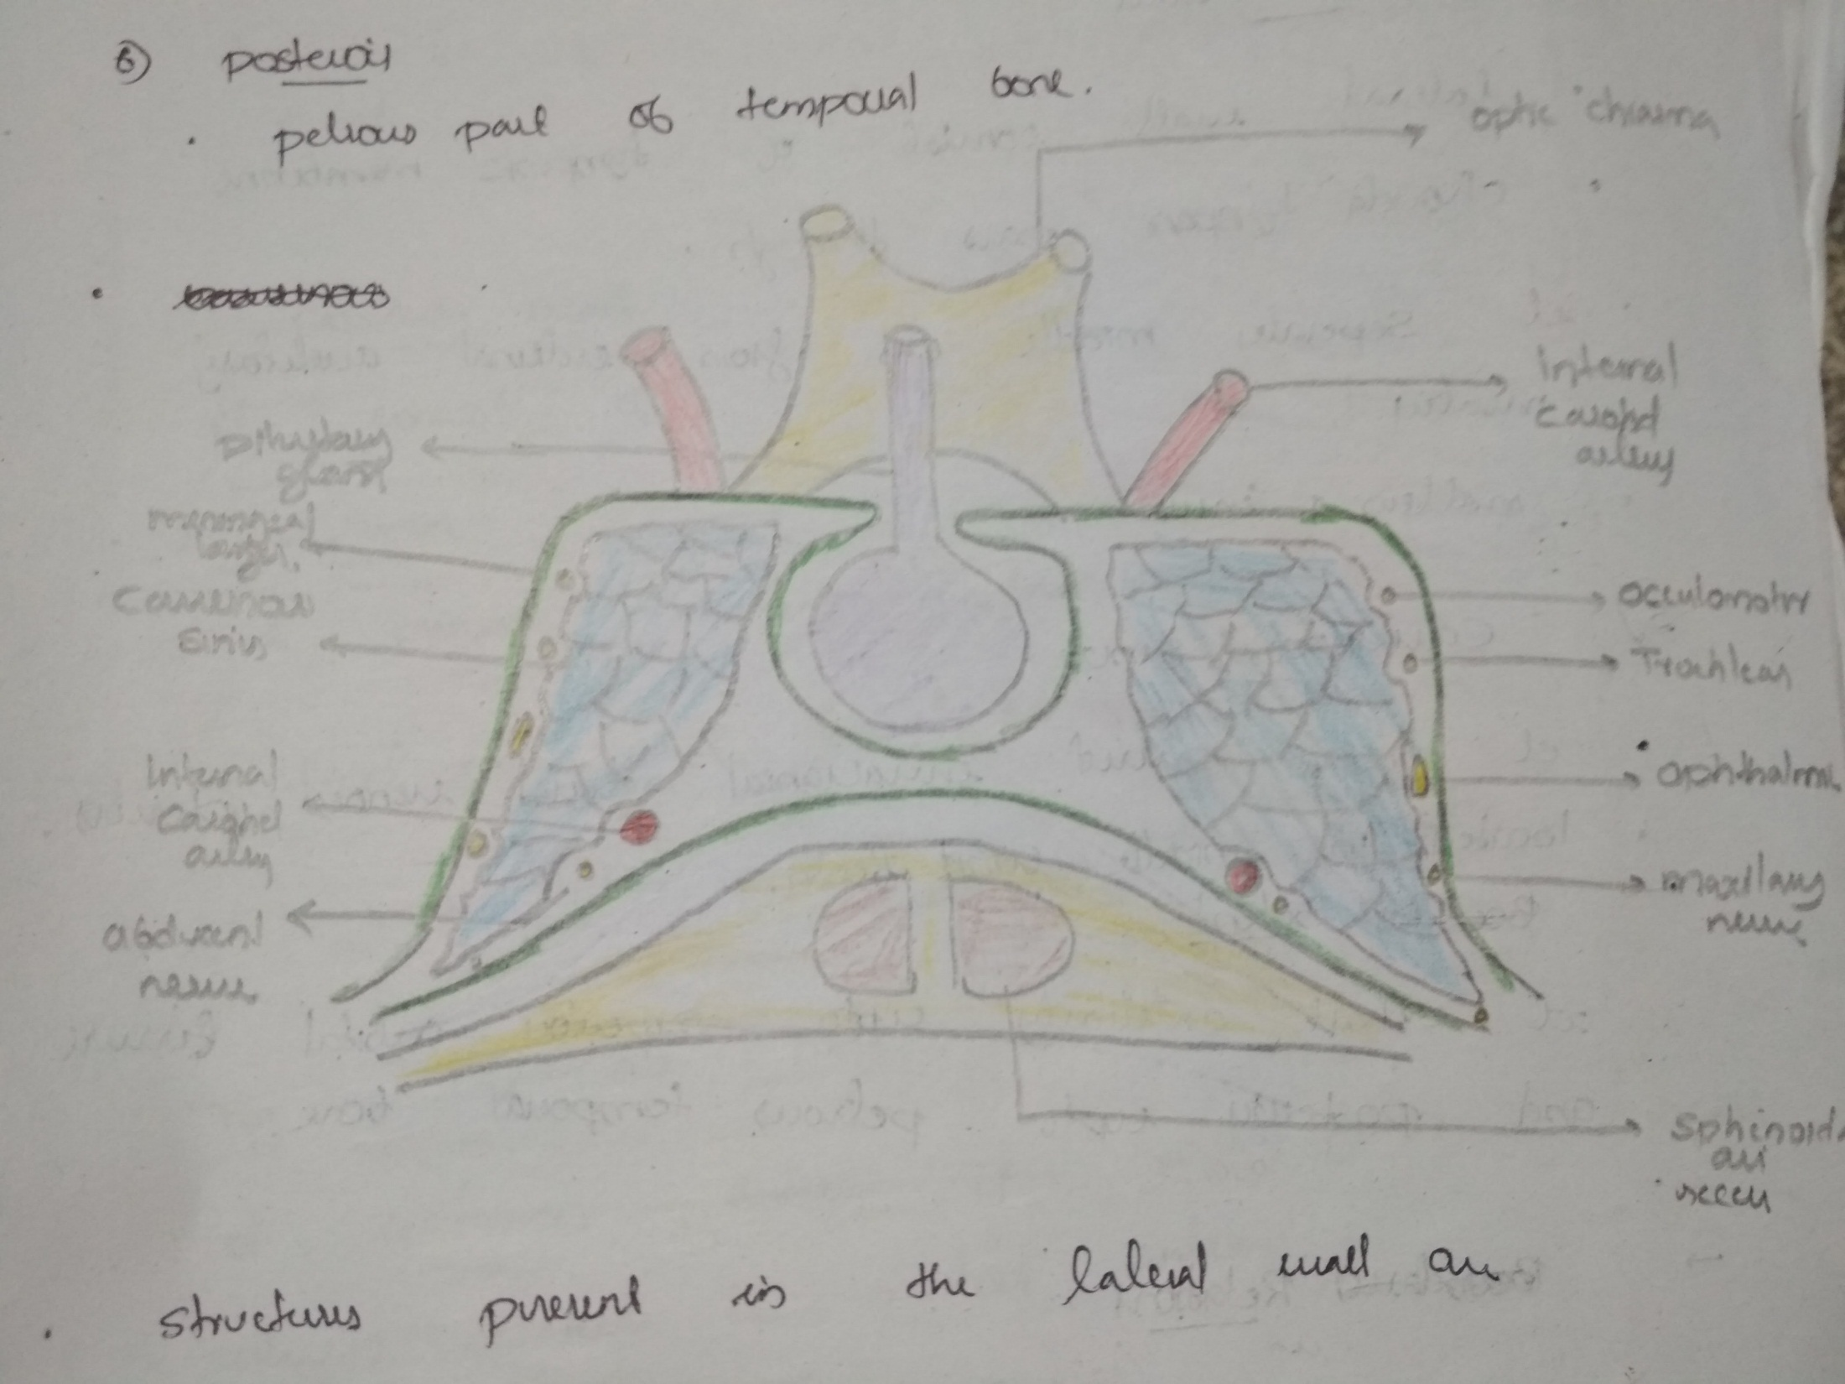
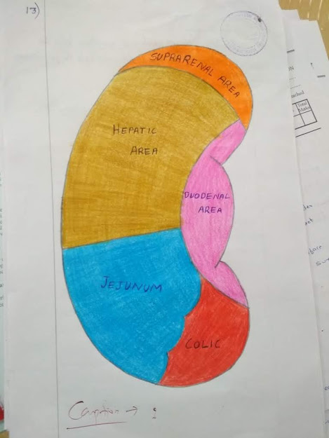
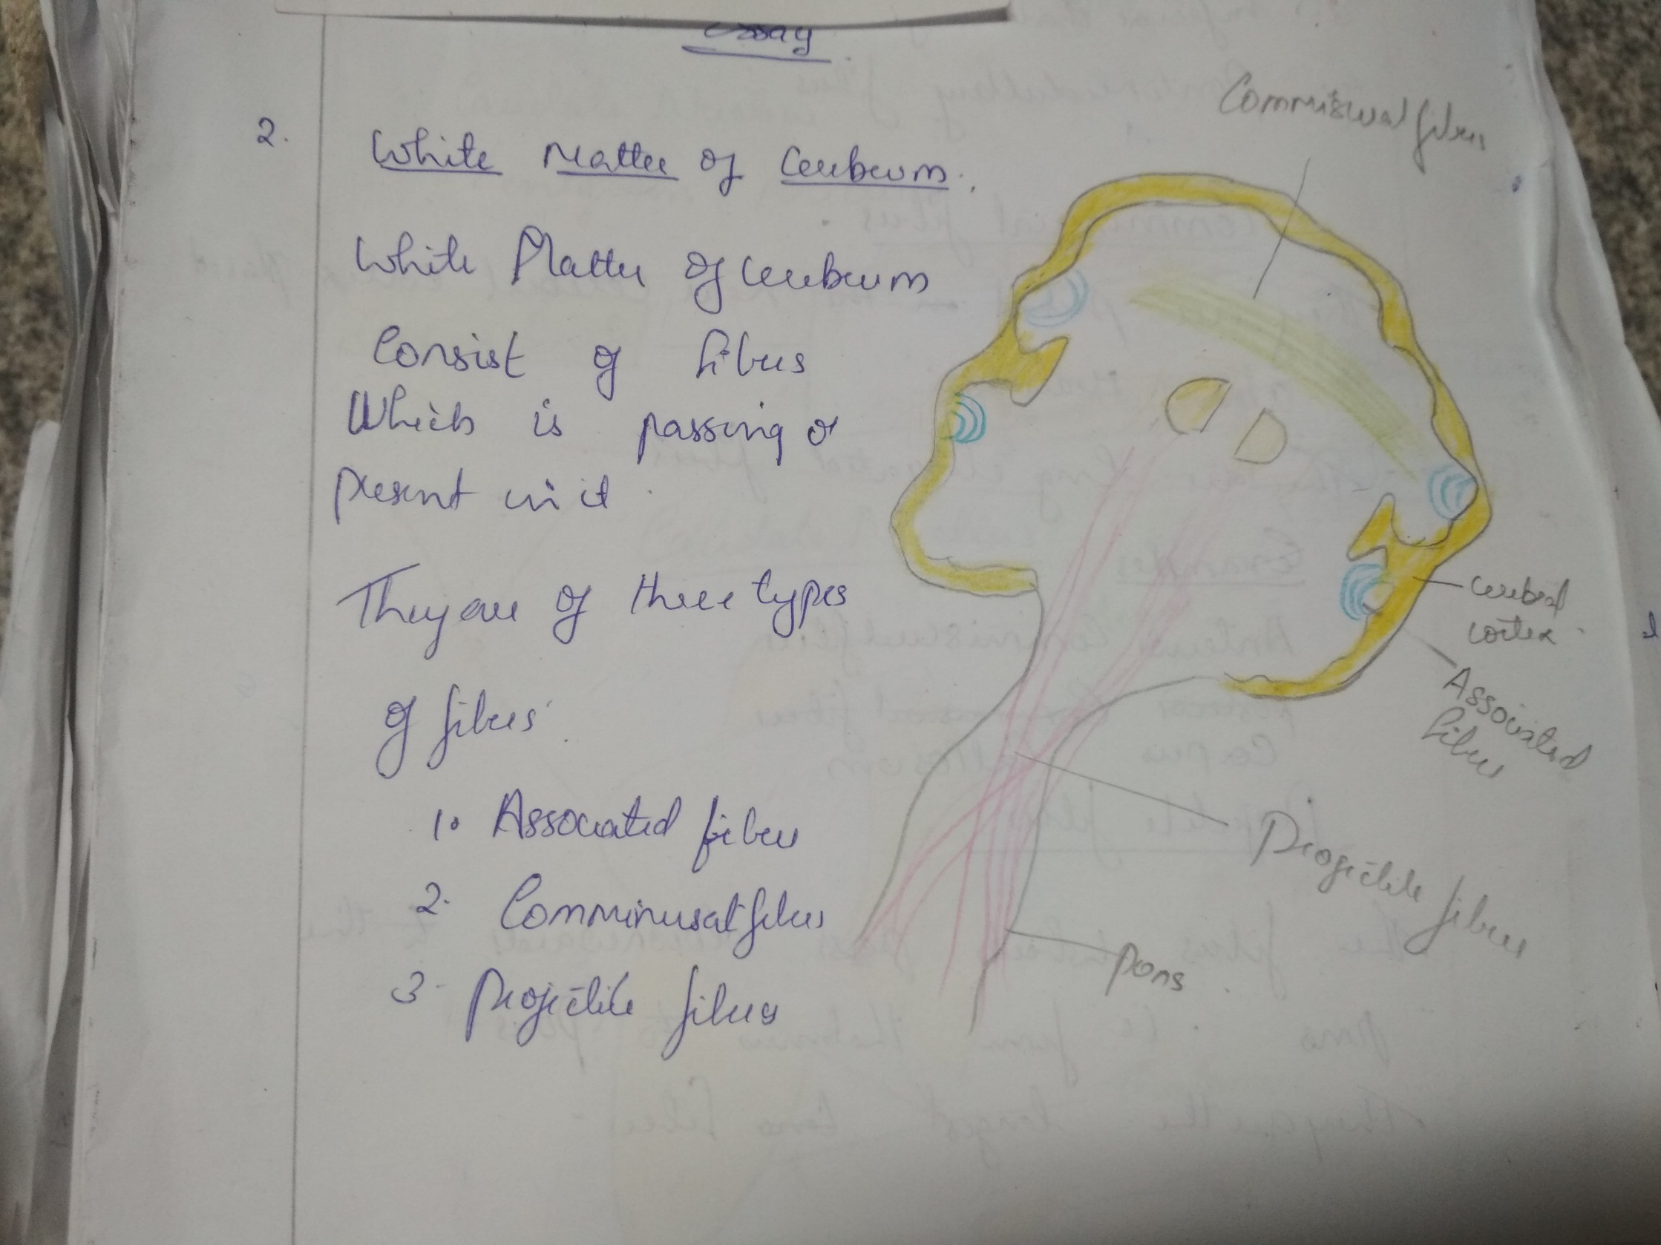

Slide 4
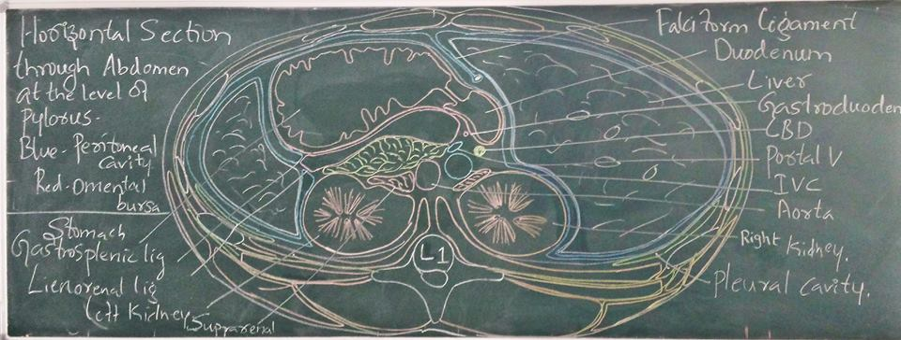
Writing diagrams on board

Slide 5
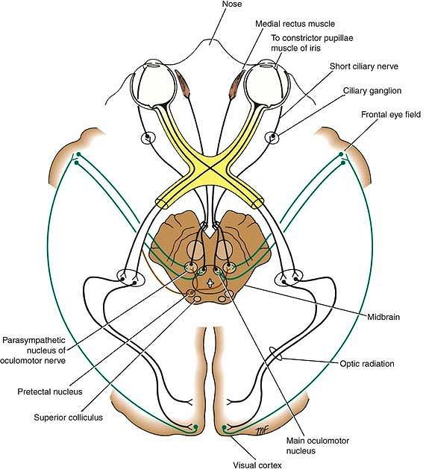
Complex diagrams
Need more planning

Slide 6
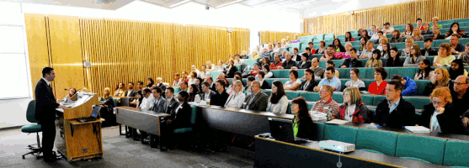
Bigger classrooms

Slide 7
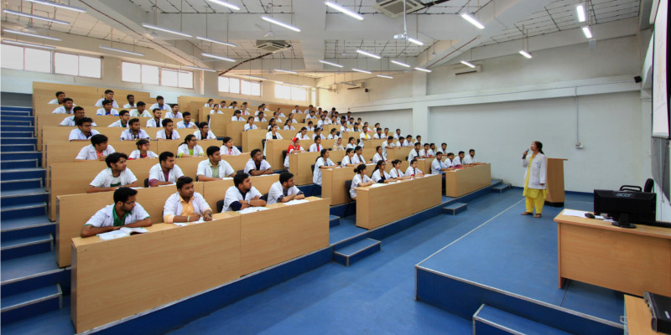
Students are smarter

Slide 8
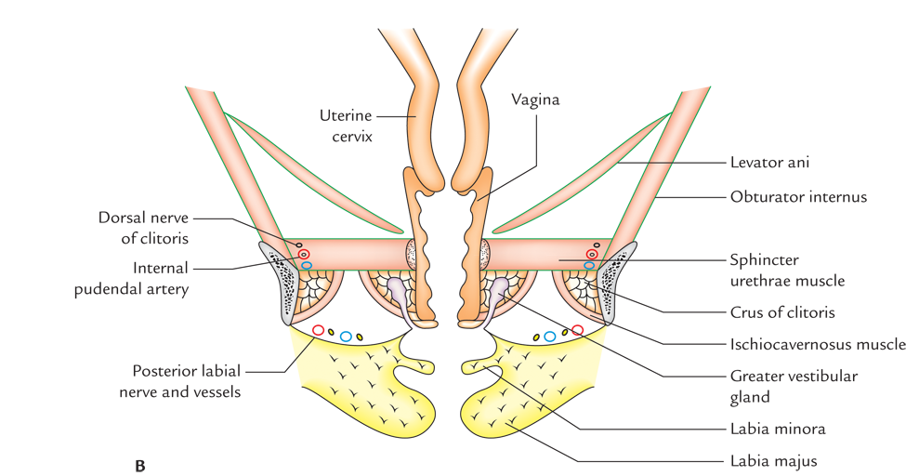
What is Sequence graphics?
Notes:
Flipped classroom is a form of blended learning in which student learns new content online by watching video lectures, usually at home, at his will. What used to be the home work or expected integration or assigned problems are done in class with teachers offering more personalised guidance and interaction with students, instead of lecturing

Slide 9

Peritoneum
Cervix
Hip bone
Ischioanal fossa
Obturator
internus
Levator ani
Corpora cavernosus + Ishiocavernosus
Sphincter urethrae
Colles’ fascia
Bulbospongiosus
Coronal section of female pelvis
Bartholin’s glands

Slide 10
Study to evaluate the sequence graphics
Objective - To evaluate sequence graphics to impart diagram writing skills among medical undergraduates

Slide 11
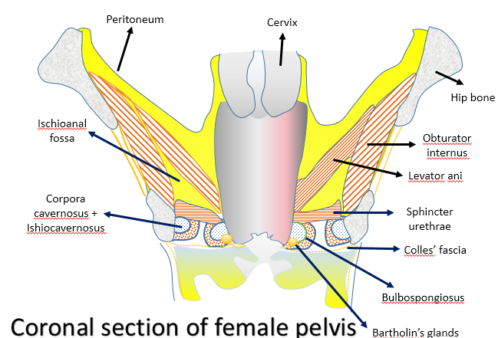
Sequence graphics
Pre-test
Parameters
Analysis

Slide 12


Results
12 students
Pre- test
Sequence graphics
Centred
Use of eraser
Stroke of pencil +
Sequence drawing
Sequence labelling
Time (average)
5
4.9
7
1
1
513 s
12
1.3
10
11
11
236 s

Slide 13
Overall – sequence graphics won!
Chaos
Confusion
Colour use
Reuse
Video - sharable

Slide 14
Sequence graphics is an effective way to impart diagram writing skills

Slide 15
How to do sequence graphics
Identify
Key component
Accessory components (few)

Slide 16
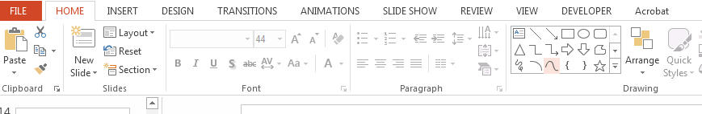
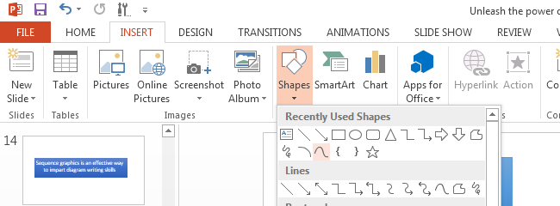
Curve line
Select the curve shape tool from the shapes gallery

Slide 17
Curve line
Click where you want the curved line or shape to begin. Click where you want the first turn in the curve to appear.
Click to add turns to the curve
To finish a line, double-click where you want the end of the curved line to appear

Slide 19
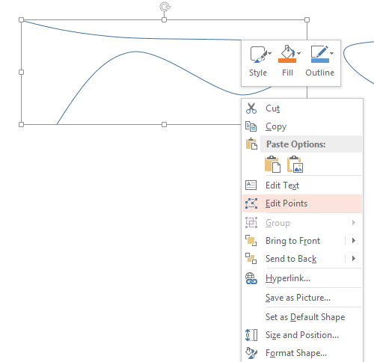
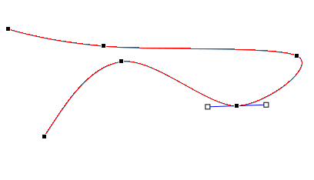
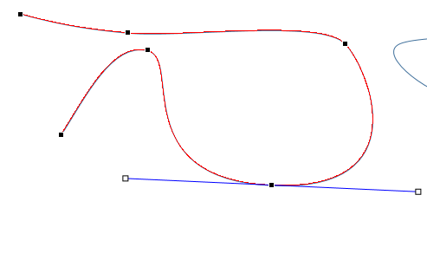
Editing points

Slide 20
Editing points video
https://www.youtube.com/watch?v=gHRlOVQSlxo

Slide 21
Sequential animation
Start
On click
With previous
After previous
Duration
Delay

Slide 22
PowerPoint Animation Tricks – video for (more)
https://www.youtube.com/watch?v=JLr_TEli3fw

Slide 23
Examples

Slide 24
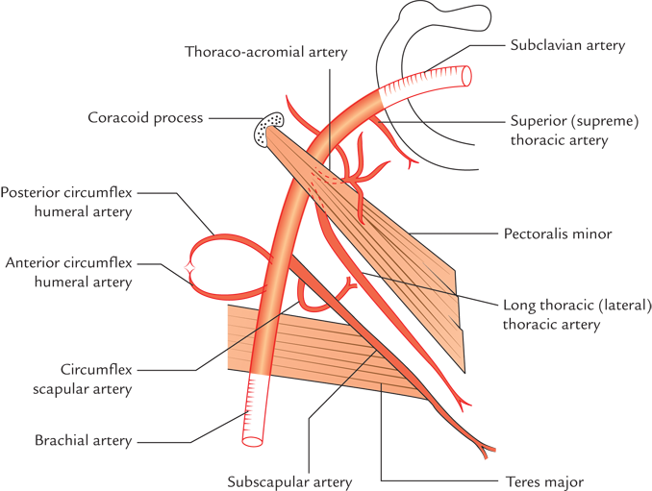

Slide 25
Axillary artery
Artery of axilla
Continuation of subclavian artery
at outer border of first rib

Slide 26
Continues as – brachial artery
At the lower border of teres major
brachial artery

Slide 27
Parts or subdivisions
By Pectoralis minor
Crosses anteriorly
1
2
3

Slide 28
Branches
Superior thoracic artery
1
Thoracoacromial artery
Lateral thoracic artery
2
Posterior circumflex humeral artery
3
Subscapular artery
Anterior circumflex humeral artery

Slide 29
Descending tracts
Ascending tracts
Fasciculus
gracilis
Fasciculus
Cuneatus
Posterolateral tract
Lateral corticospinal tract
Posterior spinocerebellar tract
Rubrospinal tract
Lateral spinothalamic tract
Anterior spinocerebellar tract
Olivospinal
tract
Spino-olivary tract
Vestibulospinal
tract
Anterior spinothalamic tract
Tectospinal
tract
Anterior corticospinal
tract

Slide 30
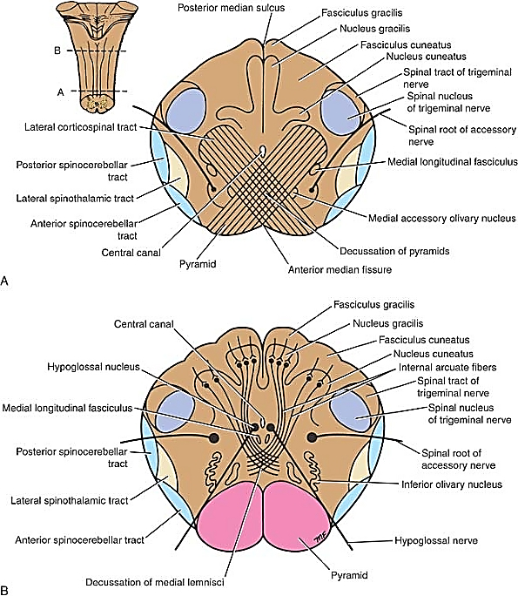
Level of Decussation of Pyramids

Slide 31
Level of Decussation of Pyramids
P
R
L
Fasciculus gracilis
A
Nucleus gracilis
Spinal tract of trigeminal nerve
Fasciculus cuneatus
Spinal nucleus of trigeminal nerve
Nucleus cuneatus
Lateral corticospinal tract
Spinal root of accessory nerve
Posterior spinocerebellar tract
Medial longitudinal
fasciculus
Lateral spinothalamic tract
Anterior spinocerebellar tract
Medial accessory olivary nucleus
Central canal
Decussation of pyramids
Anterior median fissure
Pyramid

Slide 32
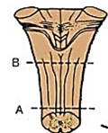
Level of Decussation of Lemnisci

Slide 33
Level of Decussation of Lemnisci
P
R
L
Fasciculus gracilis
A
Central canal
Nucleus gracilis
Spinal tract of trigeminal nerve
Fasciculus cuneatus
Spinal nucleus of trigeminal nerve
Nucleus cuneatus
Internal arcuate
fibres
Hypoglossal nucleus
Spinal root of
accessory nerve
Posterior spinocerebellar tract
Medial longitudinal
fasciculus
Lateral spinothalamic tract
Anterior spinocerebellar tract
Inferior olivary nucleus
Hypoglossal nerve
Pyramid
Decussation of medial fasciculus

Slide 34
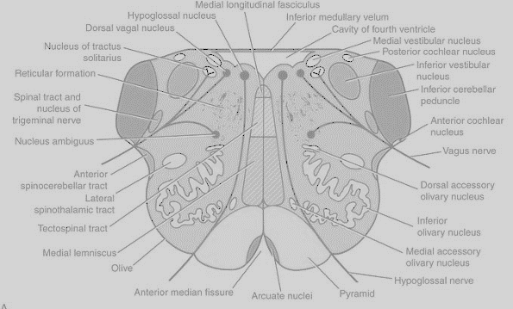
Level of the Olives

Slide 35
Level of the Olives
P
R
L
Medial longitudinal fasciculus
A
Hypoglossal Nucleus
Inferior medullary vellum
Dorsal vagal Nucleus
Cavity of 4th Ventricle
Nucleus tracus solitarius
Medial vestibular N
Posterior cochlear N
Inferior vestibular N
Reticular formation
Spinal tract & N of V
Inferior cerebellar peduncle
Nucleus ambiguus
Vagus nerve
Anterior spinocerebellar tract
Dorsal accessory olivary nucleus
Lateral
spinothalamic tract
Tectospinal tract
Inferior
olivary Nucleus
Media lemniscus
Medial accessory olivary nucleus
Olive
Hypoglossal Nerve
Anterior median fissure
Arcuate nuclei
Pyramid

Slide 36


Pretracheal fascia
Thyroid lobe
Platisma
Sternocleidomastoid
Carotid sheath
Trachea
Internal jugular V
Esophagus
Common carotid A
External jugular V
Vagus N
Vertebral artery
C6
Accessary N
Prevertebral fascia
Investing layer of deep cervical fascia
Trapezius

Slide 37
This has 112 elements animated in 17 groups

Slide 38
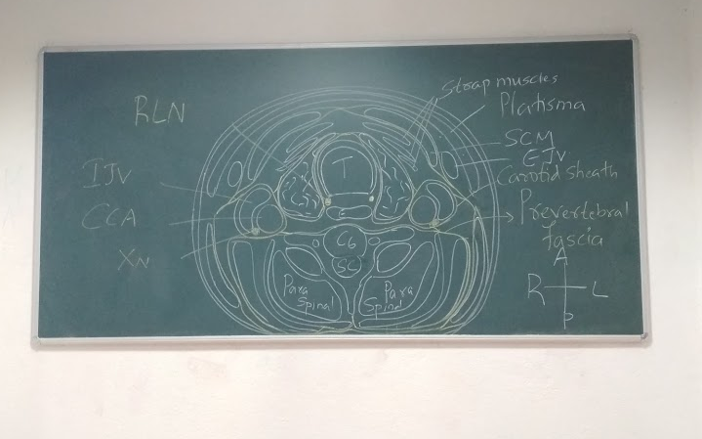

Slide 39
Principals of sequence graphics
Positioning
Line – sequencing
Skeleton – first
Label – sequencing
Key elements
Accessory elements

Slide 40
Sequence graphics to video
Microsoft office 2013 onwards
Export as MP4 video option +

Slide 41
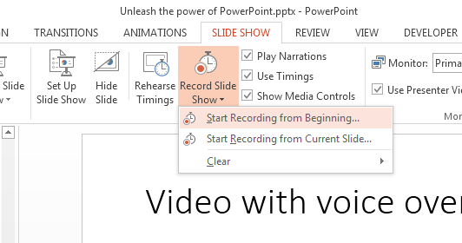
Video with voice over and cursor movements

Slide 42
Examples

Slide 43
Ascent of kidneys
https://www.youtube.com/watch?v=UhfyQ1ouJ8g

Slide 44
IVC development
PowerPoint file – display with audio narrations
https://www.youtube.com/watch?v=F83x577mtss

Slide 45
Thank you
More to come . .

